Slide 1

AP Human Geography
Mr. Lentz

Slide 2
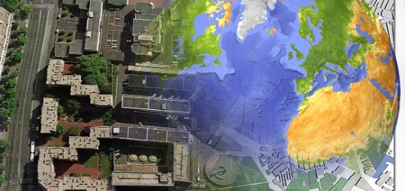
Welcome to Advanced Placement Human Geography
Advanced Academic Program
Instructor: Mr. Lentz
College Credit Course
Notes:
----- Meeting Notes (8/22/11 07:33) -----
Open House August 30, 2011

Slide 3
Welcome to College at Chino High School
Welcome to Advanced Placement
In this class…you skipped high school and walked straight in a college classroom!
Advanced Placement curriculum is college-level course work. It is NOT honors. This is COLLEGE.
If you qualified for the accelerated program= you are capable of taking on this challenging curriculum.
  Lots of work ahead of you, but it is work YOU CAN HANDLE.
Time Management = hardest task you will have all year!

Slide 4

Most Important Class Information
Course Websites: Chino High Website/Google Classroom
WHAT WE ARE GOING OVER TODAY…first day stuff ☺
What is an Advanced Placement Class
Importance of the Class Syllabus, Unit Outlines, Big Ideas
Format for the class
Materials Needed
Current Events
Lectures/discussions
Textbook Situation
Expectations
Remind 101

Slide 5

What is an Advanced Placement Class?
An opportunity to earn college credit while in high school
  Basic breakdown:
    This is a college-level class
    At the end of the year (May), you will be taking the AP Human Geography Exam. If you pass this exam, you will earn college credit (meaning you don’t have to take this class in college) – oh yeah – and your parents don’t have to pay for it!
    The test is graded on a 5 points scale
      3, 4 or 5 is considered passing
    Due to the course being so advanced, it also adds point to your GPA A = 4 points Straight As = 4.0 GPA AP classes 6.0 GPA
    Average GPA acceptance at most Universities last year was between a 3.8 and 4.5 GPA

Slide 6

Starting with the Syllabus Highlights
Course website(s)
REMIND
Textbooks
Materials
Expectations
Assessments
Homework/late work/course workload BRIEF overview
Only sign and return the last page of the Syllabus

Slide 7

What is AP Human Geography?
“Why something is happening, where it is happening, and how people are contributing to it happening.”
  We call it “The Why of Where”
You will learn everything about everything!
Topics we cover in this class
  The hardest thing as a Freshmen taking this course is not going to be the content, but the fact that you MUST manage your time MUCH better
  You must also learn the art of taking notes ☺

Slide 8
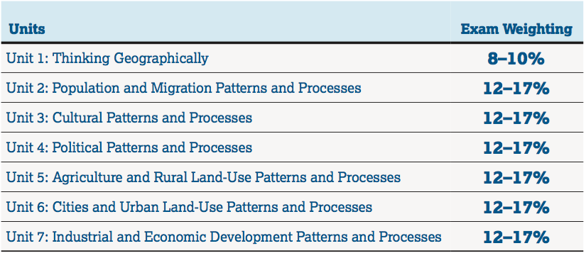
Topics Covered in This Course
Approx.
Weeks
3
6
5
5
4.5
3.5
4

Slide 9
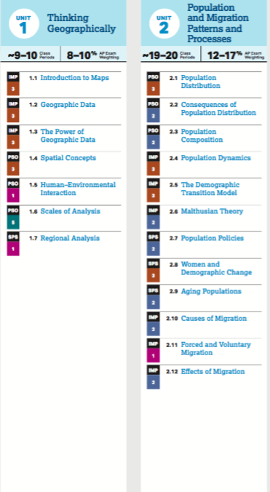
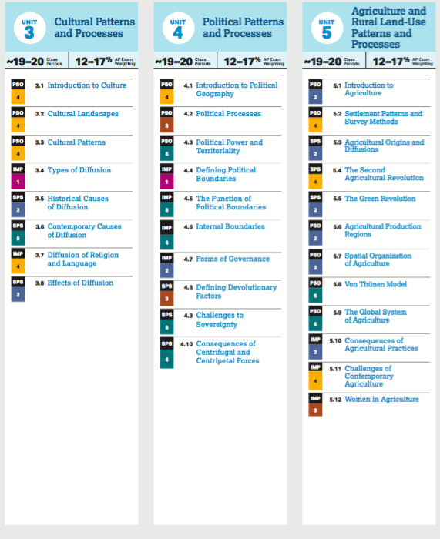

Slide 10
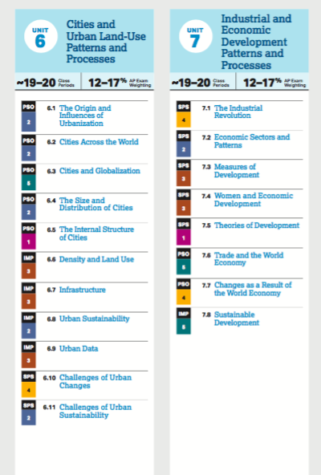

Slide 11
What IS Human Geography?
Why of where….Why is something happening – and Where is it happening.
Current Events
Analyzing and Interpreting Maps
Connecting historical events to current global issues
Global political conflicts and power struggles
Consequences of industrialization, global trade, economic development and cultural change
role of climate change and environmental abuses in shaping the human landscapes on Earth

Slide 12

Why Geography is Important!

Slide 13
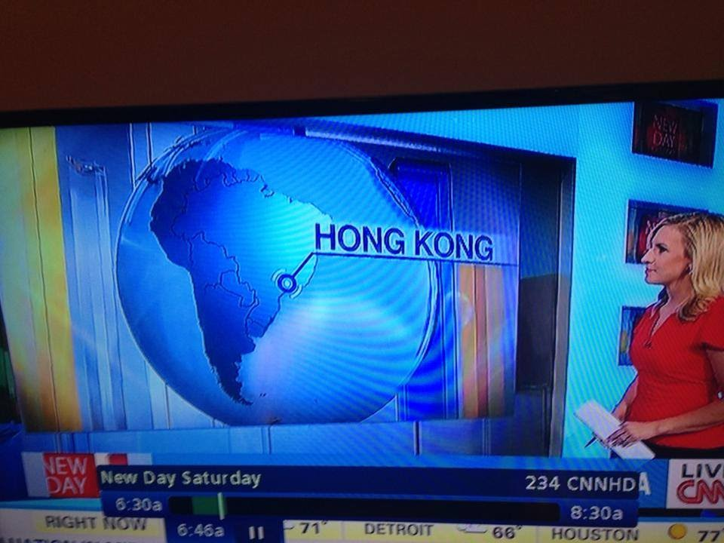

Slide 14
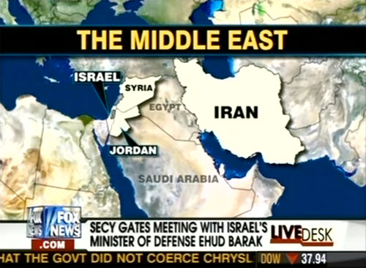

Slide 15
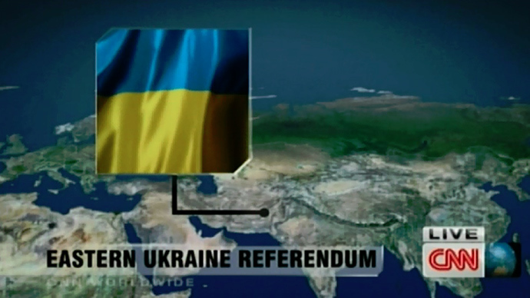

Slide 16

That is actually Iran!

Slide 17
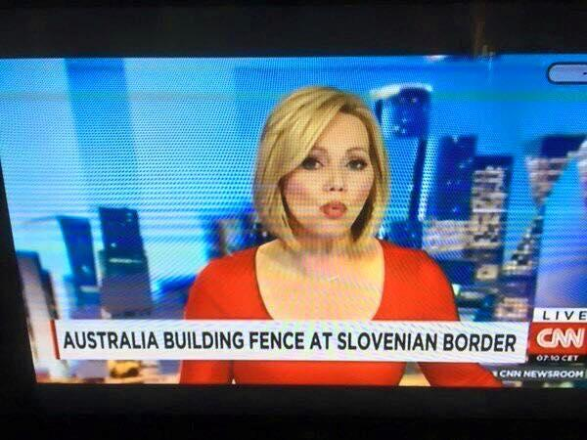

Slide 18


Slide 19
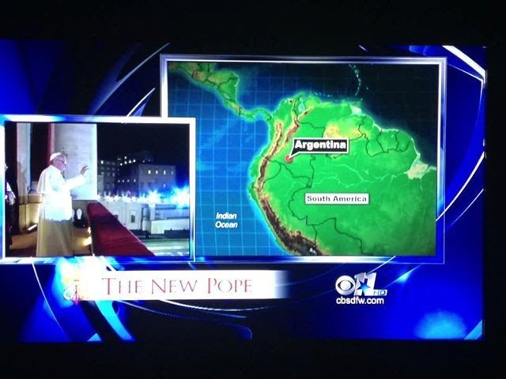

Slide 20
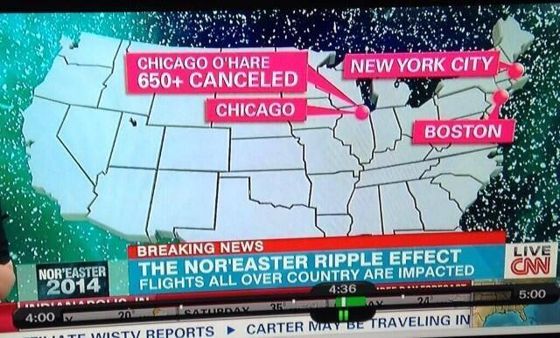

Slide 21
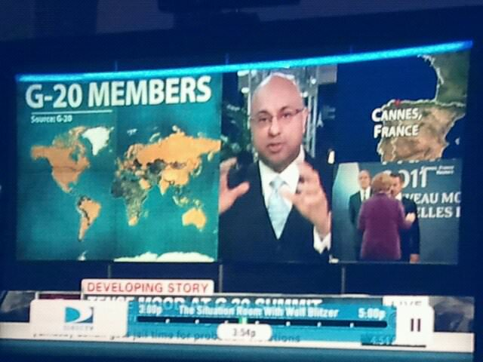
Is that Spain or France?

Slide 22


Slide 23
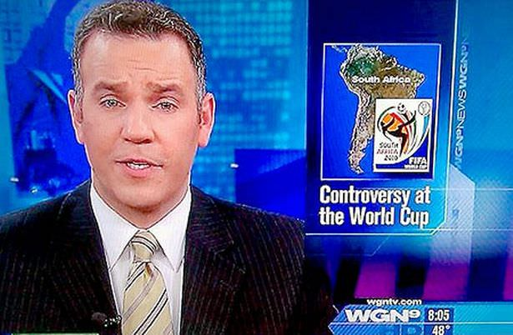

Slide 24
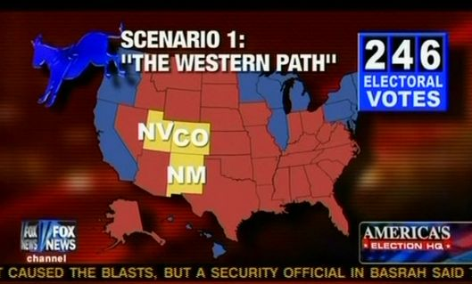

Slide 25
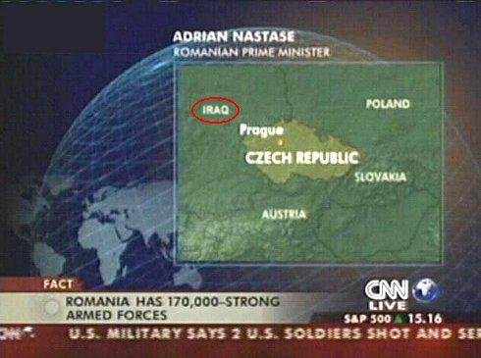

Slide 26
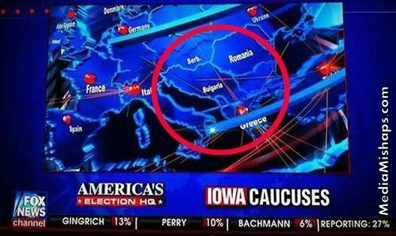
Notes:
Bulgaria is now Yugoslavia?

Slide 27
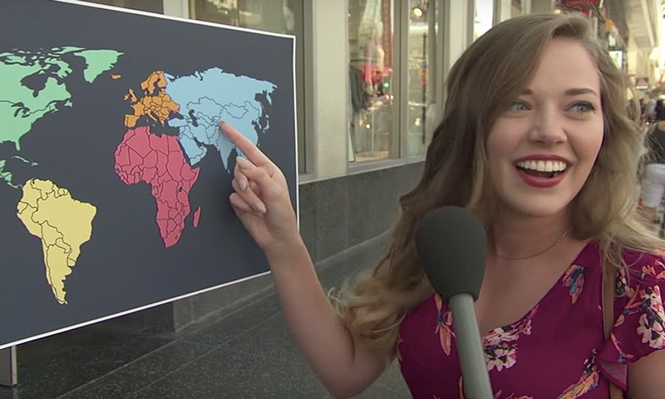
Geopolitics and Maps
https://www.youtube.com/watch?v=-ugJZhL-cbc

Slide 28
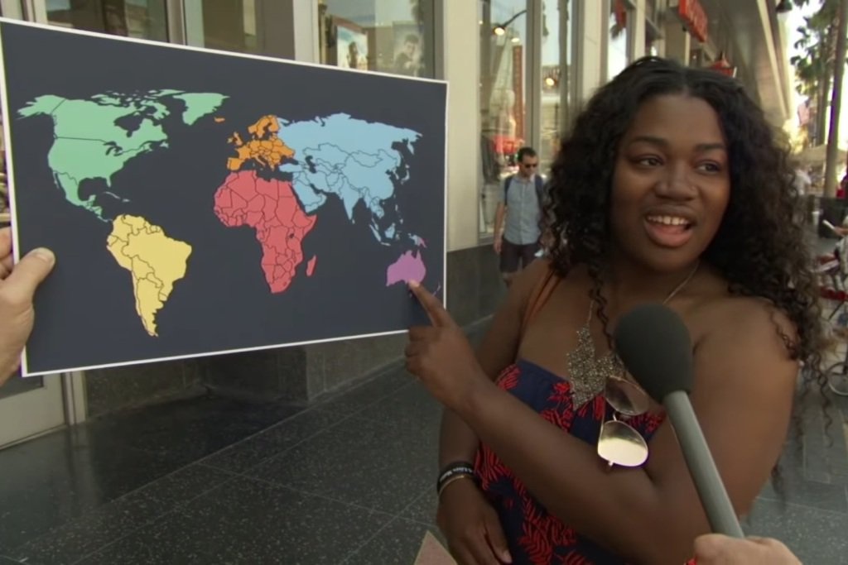
]

Slide 29
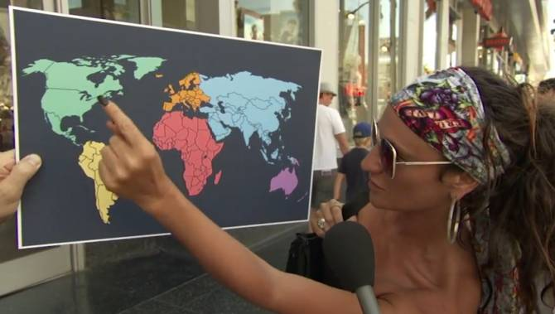
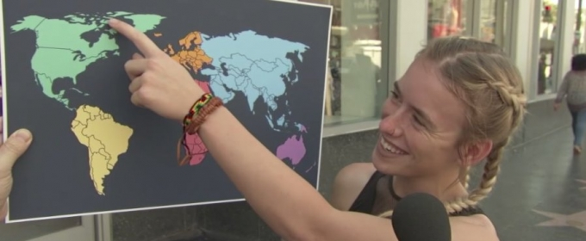
Is it Here?

Slide 30
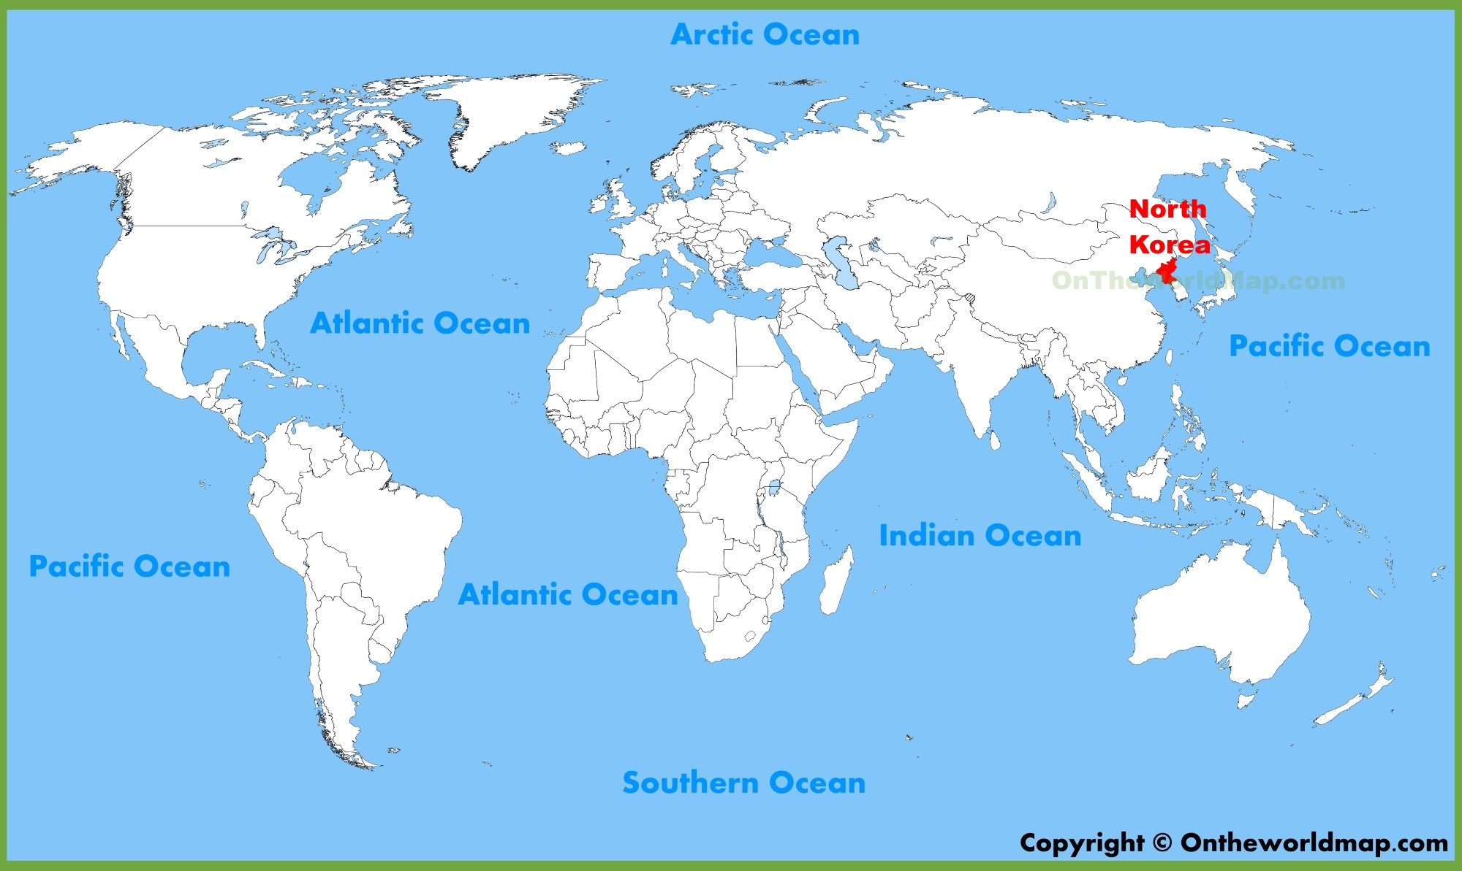
OH! Here it is!

Slide 31
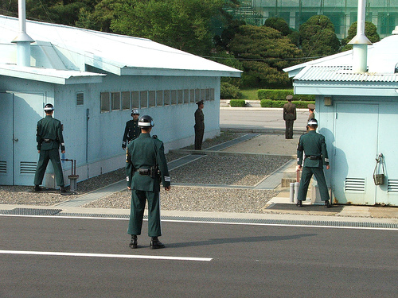
Borders are interesting!

Slide 32
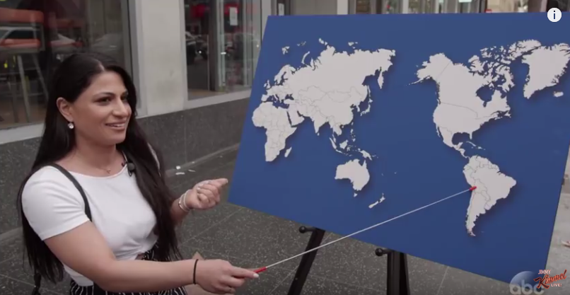
https://youtu.be/kRh1zXFKC_o
https://www.youtube.com/watch?v=kRh1zXFKC_o#action=share

Slide 33
Global migrations 2015

Slide 34
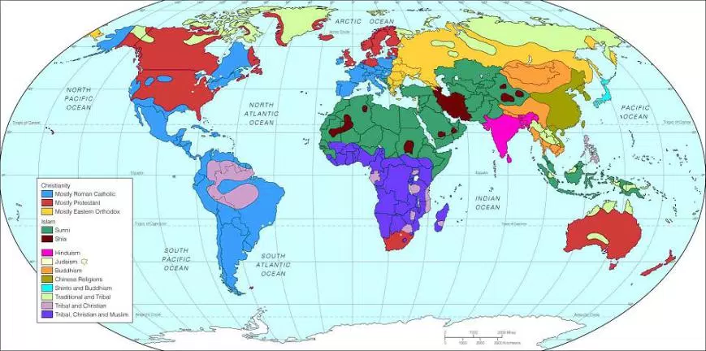
Global Religion

Slide 35
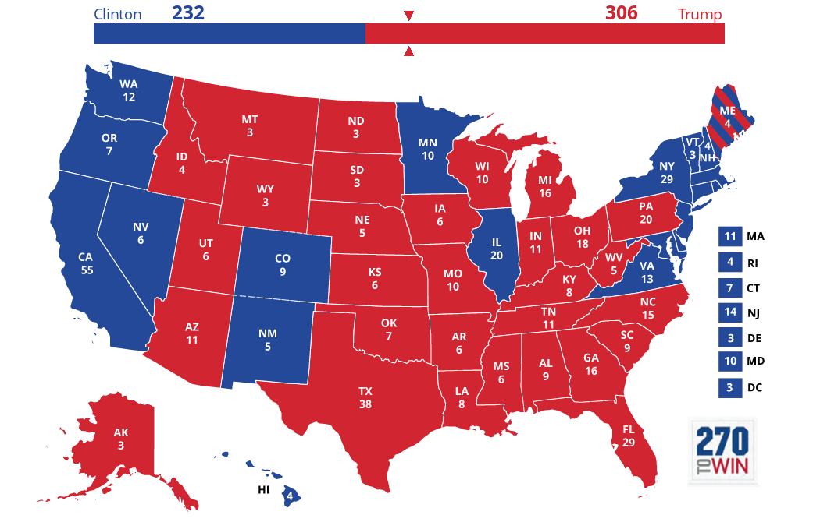
2016 Electoral Map

Slide 36
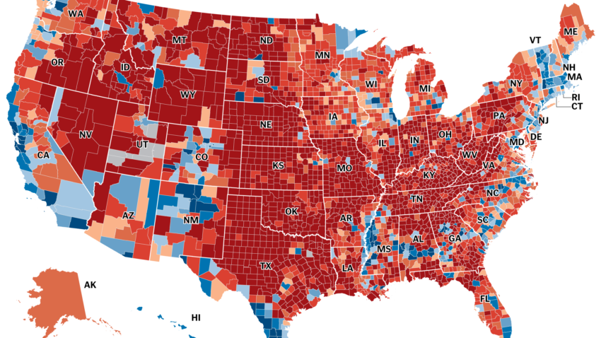
2016 Election Map by County

Slide 37
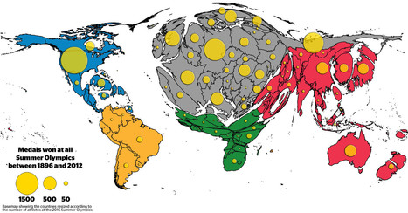
Cartograms are Cool!

Slide 38
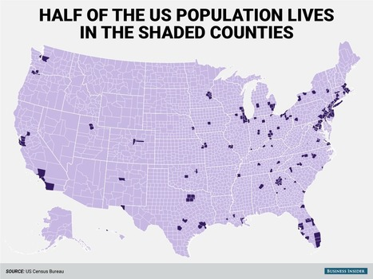

Slide 39

Supplies for the Course
Agenda- Free from the school
•One 3 Inch Binder- Only for this class
Avery Binder Tabs- 8 Tabs
Colored Notecards- As many as you can buy
Chromebook- Bring this everyday

Slide 40

Your Responsibility Once Direct Instruction is complete:
Complete Assignment/Project/Reading/etc…if one assigned due by the end of class/day OR if no assignment given due that evening, work on the following:
You should anticipate spending at least one hour every night for this course on:
  Homework assignments;
  Completing in-class assignments;
  Reading and outlining chapters from the textbook;
  Studying for quizzes, chapter tests or unit exams;
  Memorizing vocabulary;
  Using Internet-based geography games to self-test your knowledge of geography;
  Reviewing AP Exam strategies either from AP Central or tips learned in class;
  Practicing FRQs
  Working out of your review book.

Slide 41
How important is the exam?
AP Exam Scores
May 2025
50% Multiple Choice Questions
50% Written (FRQs)
There are no makeup exams for this test. This is test day – if you do not show up on time or at all, you just wasted a entire year in here!
AP SCORE QUALIFICATION
5 Extremely well qualified
4 Well qualified
3 Qualified
ABOVE IS “PASSING” - You earn college credit for taking the exam
2 Possibly qualified
1 No recommendation
AP Exam Score Equivalent College Course
Grade
FIVE (5) A
FOUR (4) A-, B+, B
THREE (3) B-, C+, C

Slide 42

Restroom Passes
You must use SMARTPASS when leaving the room for any issue.
I will not limit your restroom passes, unless you abuse the privilege. The restroom is across the hall from my classroom. You should not leave for more than 5 minutes.

Slide 43

Getting to Know You Assignment
You will be creating a cover page for your APHuG binder.
On the paper provided, give me a visual representation of YOU.
This is how myself and your fellow students will get to know you. This will be DUE FRIDAY!
Rubric:
Neatness- 10 Pts
Colored- 10 Pts

